Slide 1
Genesis Quiz
June 11

Slide 2
The word “grace” appears for the first time in the Bible in reference to what?
Noah found grace in the eyes of the Lord.
(Gen. 6:8)

Slide 3
What test did Abraham’s servant use to find Isaac a wife?
That the woman of whom he would ask a drink would consent and also offer to water his camels. (Gen. 24:14)

Slide 4
How many chapters are there in Genesis?
Fifty chapters

Slide 5
Which patriarch is specifically mentioned in the book of Genesis As giving a 10% tithe?
Jacob. We know Abraham gave 10% also, but that specific fact is in Hebrews not Genesis. (Gen. 14: 18-20, Heb. 7:1-2, Gen. 28:20-22)

Slide 6
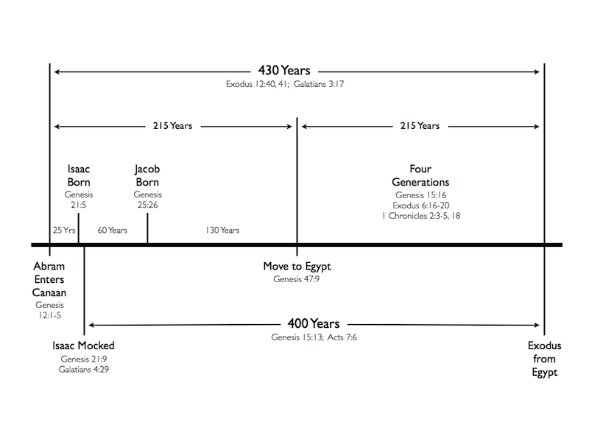
How many years elapsed between the Israelites’ entry into Egypt and the Exodus?
215 YEARS
(Gen. 15:13, Ex. 12:41, Gal. 3:17)

Slide 7
How did Abimelech learn that Sarah was Abraham’s wife and NOT just his sister?
God came to him in a dream by night. (Gen. 20:3)

Slide 8
Who was Abel’s father?
Ishmael (Gen. 4:1-2)

Slide 9
How long did Noah and his family wait on the ark before it began to rain?
Seven days (Gen. 7:1-10)

Slide 10
Who was the second oldest man who ever lived? How old was he?
Jared. He lived 962 years. (Gen. 5:20)

Slide 11
Abraham appealed to God on behalf of Sodom, asking that God not destroy the city for the sake of the righteous living there. How many people did he bargain down to?
10 people (Gen. 18:32)

Slide 12
Who was Benjamin’s father?
Jacob (Gen. 35:16-20)

Slide 13
Whose idea was it to throw Joseph into a pit rather than kill him?
Rueben suggested this, because he wanted to return Joseph to their father. (Gen. 37:21-22)

Slide 14
Who were the “Nephilim”?
The word is translated “giants” in the KJV, but probably referred to a group that was violent and thus to be feared. (Gen. 6:4)

Slide 15
What was the name of the first city?
Enoch (Gen. 4:17)

Slide 16
How many years did Methuselah live?
969 Years (Gen. 5:27)

Slide 17
Who was the eldest son of Jacob?
Reuben
(Gen. 49:3)

Slide 18
What object did Jacob give his favorite son as a mark of his favor ?
A coat of many colors
(Gen. 37:3)

Slide 19
What did God create on the first day?
Light (Gen. 1:3)

Slide 20
How old was Joseph when he reported on his brothers?
Seventeen (Gen. 37:2)

Slide 21
Who was Ishmael’s father?
Abraham (Gen. 16:1-11)

Slide 22
Rachel, Jacob’s wife, died as they journeyed away from what place?
Bethel (Gen. 35:16-18)

Slide 23
To which geographical direction did God banish Adam and Eve from the Garden of Eden?
To the East (Gen. 3:24)

Slide 24
Who was the son of Hagar?
Ishmael (Gen. 16:11)

Slide 25
What happened to lot’s wife?
She became a pillar of salt (Gen. 19:26)

Slide 26
Who was known as the mighty hunter?
Nimrod (Gen. 10:9)

Slide 27
What did God create on the second day?
The Firmament (Gen. 1:6-7)

Slide 28
How big was Noah’s ark?
It was 300 cubits long, 50 wide, and 30 high. Assuming a cubit of 20.6 inches is indicated, that’s 515 ft by 86 ft and 52 ft high. (Gen. 6:15)

Slide 29
Who was the first polygamist recorded in the Bible?
Lamech, a descendant of Cain (Gen. 4:19)

Slide 30
What relation was Methuselah to Enoch?
Methuselah was the son of Enoch (Gen. 5:21)

Slide 31
What did God create on the Fourth day?
The sun and moon (Gen. 1:14-19)

Slide 32
How many years were there between Abraham’s call and the exodus?
430 YEARS
(Gen. 15:13, Ex. 12:41, Gal. 3:17)

Slide 33
Who was the first child born on earth?
Cain (Gen. 4:1)

Slide 34
How long did the flood waters “prevail” upon the earth?
150 days (Gen. 7:24)

Slide 35
Who was Jacob’s Wife?
Rachel (Gen. 29:28)

Slide 36
How old was Noah when the flood took place?
The flood occurred in Noah’s 600th year. (Gen. 7:11)

Slide 37
What does “Jehovah-Jirah” mean?
Jehovah will provide. (Gen. 22:14)

Slide 38
What did God create on the Third day?
Dry land and vegetation
(Gen. 1:9-13)

Slide 39
A river went out of Eden and it became four rivers. What were they?
Pison, Gihon, Hiddekel, and Euphrates
(Gen. 2:10-14)

Slide 40
The Lord set a mark on cain as a warning of what?
That whoever should kill Cain would suffer vengeance sevenfold.
(Gen. 4:15)

Slide 41
What did God create on the Fifth day?
Water creatures and fowl (Gen. 1:20-23)

Slide 42
Who built the first city?
Cain (Gen. 4:17)

Slide 43
What did God create on the sixth day?
Beasts of the earth, cattle, creeping things,
Adam and Eve
(Gen. 1:24-31)

Slide 44
Who dreamed of a ladder that reached to heaven?
Jacob (Gen. 28:10-12)

Slide 45
What did Hagar name the well where God spoke to her?
Beer-lahai-roi, meaning “Well of the living One seeing me.” (Gen. 16:14)

Slide 46
Who dreamed that the sun, moon, and eleven stars bowed down before him?
Joseph
(Gen. 37:5,9)

Slide 47
How old was Enoch when God took him?
365 YEARS OLD
(Gen. 5:23)

Slide 48
What was Noah’s ark made of?
“Gopher wood” and pitch.
(Gen. 6:14)

Slide 49
Who was Noah’s father?
Lamech (Gen. 5:28-29)

Slide 50
How old was Adam when he died?
930 YEARS OLD (Gen. 5:5)

Slide 51
Whose idea was it to sell Joseph as a slave?
It was Judah’s plan. He wasn’t sure that he actually wanted to murder his brother in cold blood, though he wanted Joseph out of the way. (Gen. 37:26-27)

Slide 52
When Lot fled Sodom, for what city did he intercede?
ZOAR (Gen. 19:18-23)

Slide 53
When Lot fled Sodom, for what city did he intercede?
ZOAR (Gen. 19:18-23)

Slide 54
Who was Abraham’s heir prior to the birth of Ishmael?
Eliezer of Damascus (Gen. 15:2-3)

Slide 55
Abram lied about Sarah’s status as his wife, calling her his sister, to two different rulers. Who were they?
Pharaoh of Egypt and Abimelech, King of Gerar (Gen. 12:10-20, 20:2-18 )

Slide 56
God told Hagar something of Ishmael and his descendants. What was their character to be?
He will be a wild man, his hand against every man and every man’s hand against him. (Gen. 16:12)

